Slide 1
Predicting Restaurant Success and Rating with Yelp
Presented By –
Foram Mehta
Meenakshi Paryani
CMPE 255 Final Project under guidance of Prof. David Anastasiu Noopur Joshi

Slide 2
Motivation and Goal of our Project..
Goal
Predict Restaurant Success with Binary Classification
Predict Restaurant Rating with Multi Class Classification
Predict Restaurant Rating with Regression
Provide top 5 important features that determine the restaurant’s success
Provide top 5 negative features that determine the restaurant’s failure
Motivation
According to a frequently cited study by Ohio State University on failed restaurants,
60 % do not make it past the first year
80 % go under in 5 years

Slide 3
Features List
Alcohol | DogsAllowed | RestaurantsAttire
Ambience | DriveThru | RestaurantsDelivery
BYOBCorkage | GoodForDancing | RestaurantsGoodForGroups
BestNights | GoodForKids | RestaurantsPriceRange2
BikeParking | GoodForMeal | RestaurantsReservations
BusinessAcceptsBitcoin | HappyHour | RestaurantsTableService
BusinessAcceptsCreditCards | HasTV | RestaurantsTakeOut
BusinessParking | Music | Smoking
Caters | NoiseLevel | WheelchairAccessible
CoatCheck | OutdoorSeating | WiFi

Slide 4
Data Pre-Processing
Using Label Encoding
Converting Categorical attributes into numerical
Ex – Ambience – Classy, Casual, Dressy are given labels as Classy – 0, Dressy – 1, Casual – 2, etc.
Binarization (Get Dummies)
Mapping each categorical value to an attribute column and assigning it a value of 0/1 based on absence/presence of an attribute
Ex – Ambience – Classy, Casual, Dressy is binarized as 010 (Casual).
Test and Train Split
Used K Fold Cross Validation Technique (80/20 ratio for train/test)
Pre-Processing for Binary Classification
Pre-Processing for Multi-Class Classification
Removing Outliers

Slide 5
Dimensionality Reduction
Dimensions after Pre-Processing – 88
DR Algorithms applied – Chi Square and TruncatedSVD
Dimensions after reduction – 50 - 100
Removed Irrelevant columns which have no contribution to success prediction to improve the accuracy of the model
Ex – Address, Zip Code, BYOB
Accuracy Improved after removing irrelevant columns
Re-Processed the data again after column removal
Applied SelectKBest technique with Chi-Square Test for feature selection
Selected top 30 features from each class

Slide 6
Results - Binary Classification
Binary Classification
 | LabelEncoding |  |  | Binarization
 | Train_Accuracy | Test_Accuracy | k = number of features | Train_Accuracy | Test_Accuracy | k = number of features
MLP | 84.11 | 80.16 | 50 | 83.76 | 79.08 | 50
Random Forest | 85.99 | 77.96 | 50 | 90.1 | 78.52 | 55
AdaBoost | 83.4 | 80.53 | 55 | 83.27 | 79.77 | 45
Gaussian NB | 69.58 | 51.3 | 50 | 71.3 | 62.45 | 50
Decision Tree | 98.99 | 76.85 | 50 | 97.77 | 77.01 | 50

Slide 7
Results - MultiClass classification & Regression
Partial Dataset
 | LabelEncoding |  |  | Binarization
 | Train_Accuracy | Test_Accuracy | k = number of features | Train_Accuracy | Test_Accuracy | k = number of features
MLP | 77.3 | 75 | 50 | 76.75 | 75.01 | 50
Random Forest | 75.93 | 75 | 50 | 81.08 | 74.99 | 55
SVM | 75.6 | 74.93 | 55 | 75.59 | 74.93 | 45
Full Dataset
 | LabelEncoding |  |  | Binarization
 | Train_Accuracy | Test_Accuracy | k = number of features | Train_Accuracy | Test_Accuracy | k = number of features
MLP | 62.7 | 62.7 | 50 | 63.87 | 62.45 | 50
Random Forest | 65 | 62.8 | 50 | 68.87 | 62.46 | 55
SVM | 61.52 | 61.35 | 55 | 61.58 | 61.46 | 45
Partial Dataset |  |  |  |  | Full Dataset
 | SSE_Train | Variance_Train | SSE_Test | Variance_Test | SSE_Train | Variance_Train | SSE_Test | Variance_Test
LabelEncoding | 0.31 | 0.1 | 0.32 | 0.09 | 0.56 | 0.08 | 0.57 | 0.08
Binarizarion | 0.29 | 0.17 | 0.3 | 0.14 | 0.53 | 0.14 | 0.53 | 0.15

Slide 8
Best Positive Features & Negative Features
Positive Best Features | Negative Features
WiFi | Karaoke Features
Business Parking | Validated Business Parking
Ambience | Best Nights
Price Range | Video Music
Attire
Type of Meal

Slide 9
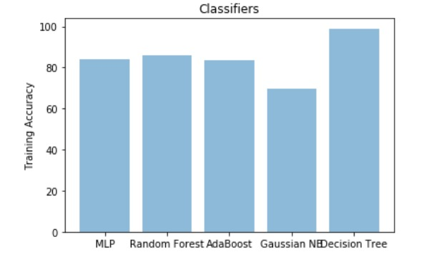
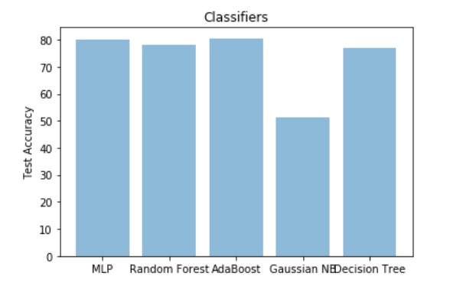
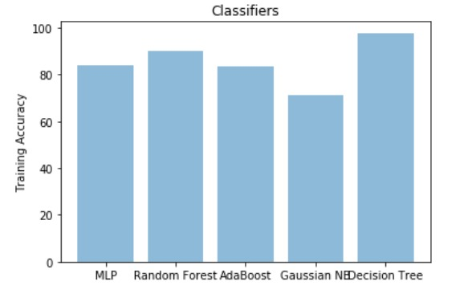
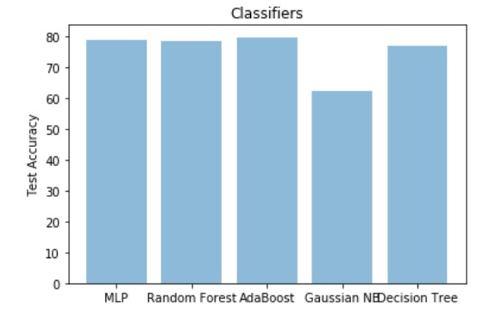
Results - Binary Classification

Slide 10
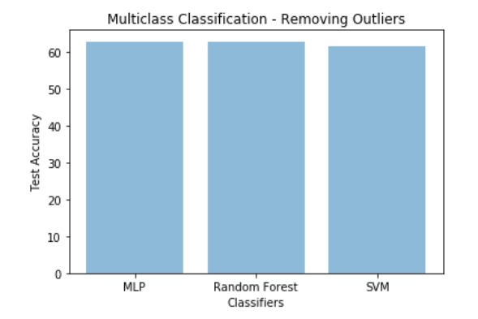
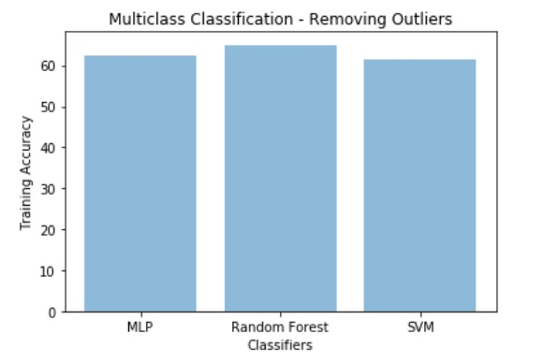
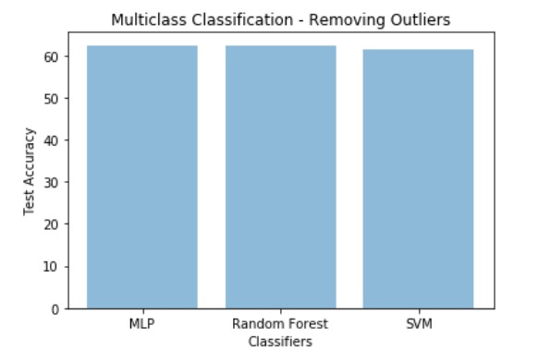
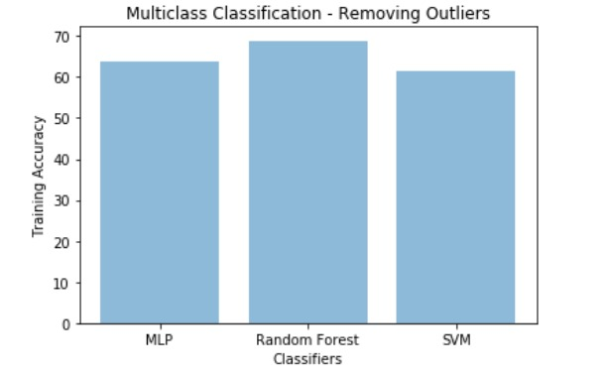
Results – Multi Class Classification

Slide 11
Demo

